Slide 1

Control Flow

Slide 2
If Conditions

Slide 3
If Conditions
Why If Conditions

Slide 4
If Conditions
If conditions are used to control the flow of execution based on certain conditions. They allow the program to make decisions based on whether a certain condition is true or false, and execute different blocks of code accordingly.

Slide 5
If Conditions
If conditions are used to control the flow of execution based on certain conditions. They allow the program to make decisions based on whether a certain condition is true or false, and execute different blocks of code accordingly.

Slide 6
If Conditions
There are many scenarios where if conditions are useful in Python, some of which include:
Conditional statements: if conditions are commonly used to implement conditional statements in Python, such as if-else and if-elif-else statements. These allow the program to make different decisions based on different conditions.
Looping constructs: if conditions are also used in various looping constructs, such as for loops and while loops. They allow the program to skip certain iterations of the loop or terminate the loop early based on certain conditions.
Input validation: if conditions are often used for input validation, where the program checks if the input provided by the user meets certain criteria or not. For example, a program that asks the user to enter their age may use an if condition to check if the input is a positive integer.

Slide 7
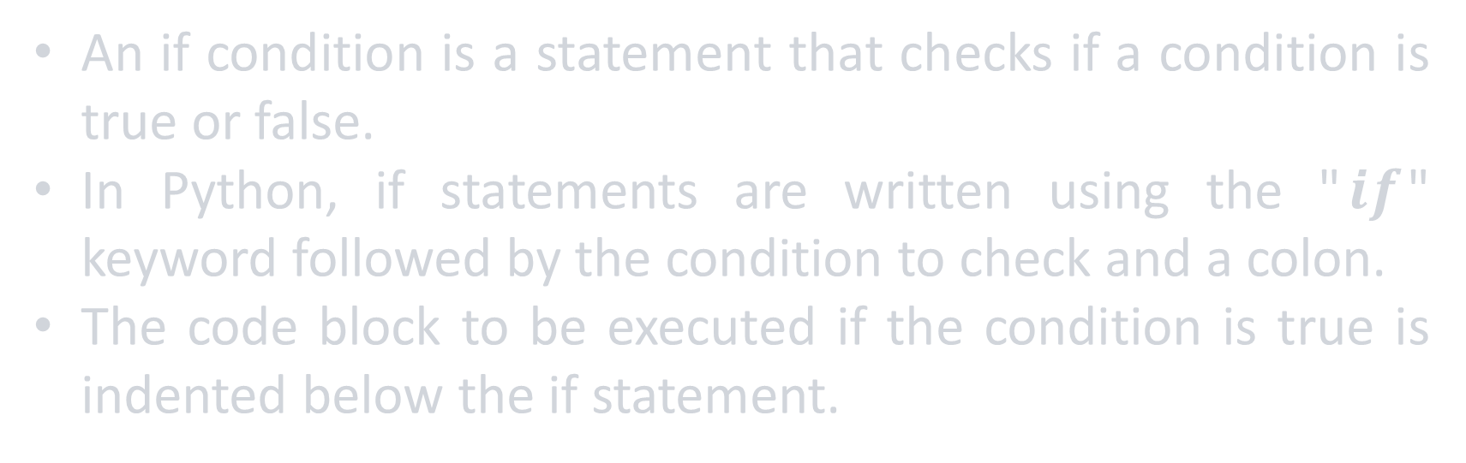
If Conditions
An if condition is a statement that checks if a condition is true or false.
In Python, if statements are written using the "$if$" keyword followed by the condition to check and a colon.
The code block to be executed if the condition is true is indented below the if statement.

Slide 8
If Conditions
An if condition is a statement that checks if a condition is true or false.
In Python, if statements are written using the "$if$" keyword followed by the condition to check and a colon.
The code block to be executed if the condition is true is indented below the if statement.
x = 10
if x > 5:
print("x is greater than 5")

Slide 9
If Conditions
An if condition is a statement that checks if a condition is true or false.
In Python, if statements are written using the "$if$" keyword followed by the condition to check and a colon.
The code block to be executed if the condition is true is indented below the if statement.
x = 10
if x > 5:
print("x is greater than 5")
>> x is greater than 5

Slide 10
If Conditions
x = 10
if x > 5:
print("x is greater than 5")
Built in keyword

Slide 11
If Conditions
x = 10
if x > 5:
print("x is greater than 5")
The condition

Slide 12
If Conditions
A colon representing the end of the condition
x = 10
if x > 5:
print("x is greater than 5")

Slide 13
If Conditions
The code to be executed if the condition is true
x = 10
if x > 5:
print("x is greater than 5")

Slide 14
If Conditions
x = 10
if x > 5:
print("x is greater than 5")
Indentation

Slide 15
If Conditions
x = 10
if x > 5:
print("x is greater than 5")
>> IndentationError: expected an indented block

Slide 16
If Conditions
x = 10
if x > 5: print("x is greater than 5")
>> x is greater than 5

Slide 17
If-Else Conditions

Slide 18
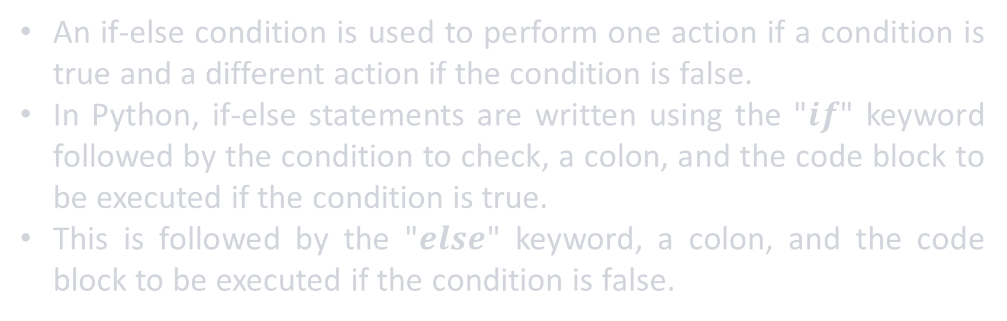
If-Else Conditions
An if-else condition is used to perform one action if a condition is true and a different action if the condition is false.
In Python, if-else statements are written using the "$if$" keyword followed by the condition to check, a colon, and the code block to be executed if the condition is true.
This is followed by the "$else$" keyword, a colon, and the code block to be executed if the condition is false.

Slide 19
If-Else Conditions
An if-else condition is used to perform one action if a condition is true and a different action if the condition is false.
In Python, if-else statements are written using the "$if$" keyword followed by the condition to check, a colon, and the code block to be executed if the condition is true.
This is followed by the "$else$" keyword, a colon, and the code block to be executed if the condition is false.
x = 3
if x > 5:
print("x is greater than 5")
>>

Slide 20
If-Else Conditions
An if-else condition is used to perform one action if a condition is true and a different action if the condition is false.
In Python, if-else statements are written using the "$if$" keyword followed by the condition to check, a colon, and the code block to be executed if the condition is true.
This is followed by the "$else$" keyword, a colon, and the code block to be executed if the condition is false.
x = 3
if x > 5:
print("x is greater than 5")
else:
print("x is less than or equal to 5")
>> x is less than or equal to 5

Slide 21
If-Else Conditions
x = 3
if x > 5:
print("x is greater than 5")
else:
print("x is less than or equal to 5")
Built in keyword
Indentation

Slide 22
If-Else Conditions
x = 3
if x > 5:
print("x is greater than 5")
else:
print("x is less than or equal to 5")
Followed by a colon without any conditions

Slide 23
If-Else Conditions
x = 3
if x > 5:
print("x is greater than 5")
else:
print("x is less than or equal to 5")

Slide 24
If-Else Conditions
x = 3
if x > 5: print("x is greater than 5")
else: print("x is less than or equal to 5")
>> x is less than or equal to 5

Slide 25
If-Else Conditions
x = 3
print("x is greater than 5") if x > 5 else print("x is less than 5")
>> x is less than 5

Slide 26
If-Else Conditions
x = 3
print("x is greater than 5") if x > 5 else print("x is less than 5")
>> x is less than 5
This technique is known as Ternary Operators, or Conditional Expressions.

Slide 27
If-Else Conditions
x = 3
print("x is greater than 5") if x > 5 else print("x is less than 5")
>> x is less than 5
Will print “x is greater than 5” only if x > 5

Slide 28
If-Else Conditions
x = 3
print("x is greater than 5") if x > 5 else print("x is less than 5")
>> x is less than 5
Other wise will print “x is less than 5”

Slide 29
If-Else Conditions
x = 3
print("x is greater than 5") if x > 5 else print("x is less than 5")
>> x is less than 5

Slide 30
If-Else Conditions
x = 3
if x > 5:
print("x is greater than 5")
else:
print("x is less than or equal to 5")

Slide 31
Nested If-Else Conditions
x = 3
if x > 5:
print("x is greater than 5")
else:
if x == 5:
print("x is equal to 5")
else:
print("x is less than 5")
>> x is less than 5

Slide 32
Nested If-Else Conditions
x = 3
if x > 5: print("x is greater than 5")
else:
if x == 5: print("x is equal to 5")
else: print("x is less than 5")
>> IndentationError: unexpected indent

Slide 33
Nested If-Else Conditions
x = 3
if x > 5: print("x is greater than 5")
else:
if x == 5: print("x is equal to 5")
else: print("x is less than 5")
>> x is less than 5

Slide 34
Elif Conditions

Slide 35
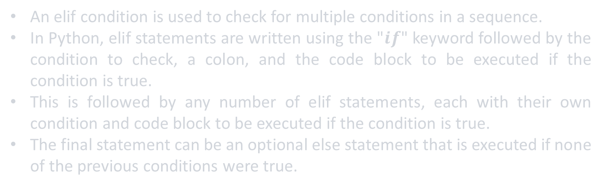
Elif Conditions
An elif condition is used to check for multiple conditions in a sequence.
In Python, elif statements are written using the "$if$" keyword followed by the condition to check, a colon, and the code block to be executed if the condition is true.
This is followed by any number of elif statements, each with their own condition and code block to be executed if the condition is true.
The final statement can be an optional else statement that is executed if none of the previous conditions were true.

Slide 36
Elif Conditions
An elif condition is used to check for multiple conditions in a sequence.
In Python, elif statements are written using the "$if$" keyword followed by the condition to check, a colon, and the code block to be executed if the condition is true.
This is followed by any number of elif statements, each with their own condition and code block to be executed if the condition is true.
The final statement can be an optional else statement that is executed if none of the previous conditions were true.
x = 5
if x > 5:
print("x is greater than 5")
elif x == 5:
print("x is equal to 5")
else:
print("x is less than 5")

Slide 37
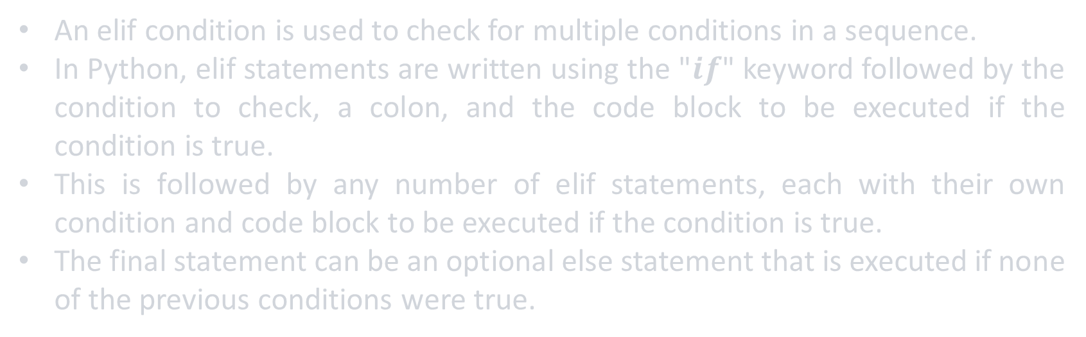
Elif Conditions
An elif condition is used to check for multiple conditions in a sequence.
In Python, elif statements are written using the "$if$" keyword followed by the condition to check, a colon, and the code block to be executed if the condition is true.
This is followed by any number of elif statements, each with their own condition and code block to be executed if the condition is true.
The final statement can be an optional else statement that is executed if none of the previous conditions were true.
x = 5
if x > 5:
print("x is greater than 5")
elif x == 5:
print("x is equal to 5")
else:
print("x is less than 5")
>> x is equal to 5

Slide 38
Elif Conditions
x = 5
if x > 5:
print("x is greater than 5")
elif x == 5:
print("x is equal to 5")
else:
print("x is less than 5")
Built in keyword

Slide 39
Elif Conditions
elif x == 5:
print("x is equal to 5")
else:
print("x is less than 5")
x = 5
if x > 5:
print("x is greater than 5")
elif must have a condition within it

Slide 40
Elif Conditions
x = 5
if x > 5:
print("x is greater than 5")
elif x == 5:
print("x is equal to 5")
else:
print("x is less than 5")

Slide 41
Elif Conditions
x = 5
if x > 5: print("x is greater than 5")
elif x == 5: print("x is equal to 5")
else: print("x is less than 5")
>> x is equal to 5

Slide 42
Elif Conditions
x = 5
print("greater") if x > 5 else print("equal") if x == 5 else print("less")
>> equal

Slide 43
Example
Write a program that checks the student’s score:
if the student's grade is greater than or equal to 85, print Excellent
if the student's grade is between 75 and 85, print Very Good
if the student's grade is between 65 and 75, print Good
if the student's grade is between 50 and 65, print Acceptable
otherwise print Weak

Slide 44
Example
student_grade = 80
if student_grade >= 85:
print("Excellent")
elif student_grade >= 75 and student_grade < 85:
print("Very Good")
elif student_grade >= 65 and student_grade < 75:
print("Good")
elif student_grade >= 50 and student_grade < 65:
print("Acceptable")
else:
print("Weak")
student_grade > 85 or student_grade == 85
>> Very Good

Slide 45
Loops

Slide 46
Loops

Slide 47
Loops
Why Loops?

Slide 48
Loops
Loops are an essential part of programming because they allow you to execute a block of code repeatedly based on a specific condition.

Slide 49
Loops
Loops can be used for a variety of tasks, such as:
Processing large amounts of data or lists.
Repeating a task a specific number of times.
Iterating through a range of numbers.
Continuously polling for new data or updates.
Running a game loop or simulation.

Slide 50
Loops
Overall, loops are a powerful tool in any programming language that can help you automate repetitive tasks and make your code more efficient and effective.

Slide 51
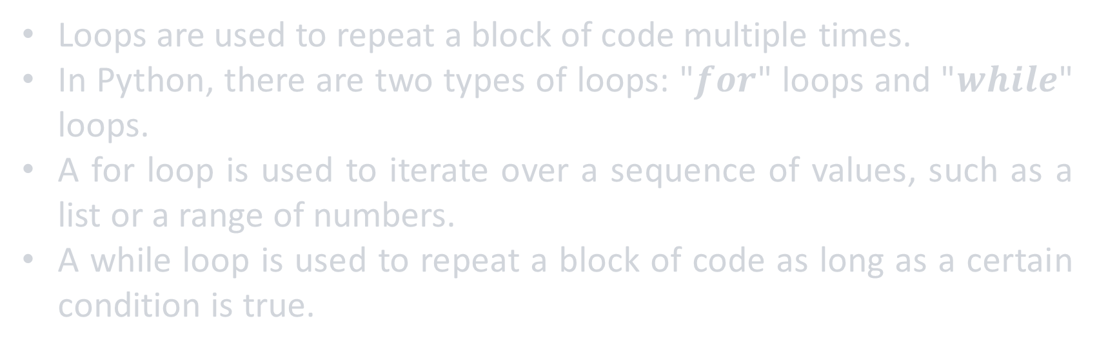
Loops
Loops are used to repeat a block of code multiple times.
In Python, there are two types of loops: "$for$" loops and "$while$" loops.
A for loop is used to iterate over a sequence of values, such as a list or a range of numbers.
A while loop is used to repeat a block of code as long as a certain condition is true.

Slide 52
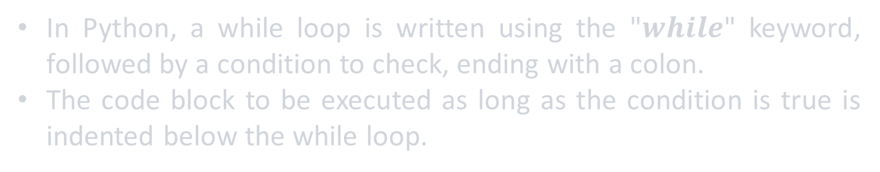
While Loops
In Python, a while loop is written using the "$while$" keyword, followed by a condition to check, ending with a colon.
The code block to be executed as long as the condition is true is indented below the while loop.

Slide 53
While Loops
In Python, a while loop is written using the "$while$" keyword, followed by a condition to check, ending with a colon.
The code block to be executed as long as the condition is true is indented below the while loop.
x = 1
while x < 5:
print(x)
x += 1

Slide 54
While Loops
In Python, a while loop is written using the "$while$" keyword, followed by a condition to check, ending with a colon.
The code block to be executed as long as the condition is true is indented below the while loop.
x = 1
while x < 5:
print(x)
x += 1
>> 1
2
3
4

Slide 55
While Loops
x = 1
while x < 5:
print(x)
x += 1

Slide 56
While Loops
Built in keyword
The condition
x = 1
while x < 5 :
print(x)
x += 1
A colon represents the end of the condition
The peace of code to be repeated
Indentation

Slide 57
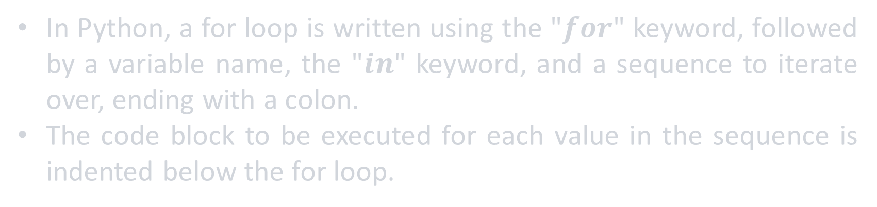
for Loops
In Python, a for loop is written using the "$for$" keyword, followed by a variable name, the "$in$" keyword, and a sequence to iterate over, ending with a colon.
The code block to be executed for each value in the sequence is indented below the for loop.

Slide 58
for Loops
In Python, a for loop is written using the "$for$" keyword, followed by a variable name, the "$in$" keyword, and a sequence to iterate over, ending with a colon.
The code block to be executed for each value in the sequence is indented below the for loop.
fruits = ["apple", "banana", "orange"]
for fruit in fruits:
print(fruit)
>> apple
banana
orange

Slide 59
for Loops
fruits = ["apple", "banana", "orange"]
for fruit in fruits:
print(fruit)

Slide 60
for Loops
fruits = ["apple", "banana", "orange"]
for fruit in fruits:
print(fruit)
List of elements
(iterable sequence )

Slide 61
for Loops
Built in keyword
fruits = ["apple", "banana", "orange"]
for fruit in fruits:
print(fruit)
variable

Slide 62

for Loops
number_of_iterations = 3
fruits = ["apple", "banana", "orange"]
for fruit in fruits:
print(fruit)

Slide 63
for Loops
number_of_iterations = 3
fruits = ["apple", "banana", "orange"]
for fruit in fruits:
print(fruit)

Slide 64
for Loops
number_of_iterations = 3
fruit = "apple"
fruits = ["apple", "banana", "orange"]
for fruit in fruits:
print(fruit)

Slide 65
for Loops
number_of_iterations = 3
fruit = "apple"
fruits = ["apple", "banana", "orange"]
for fruit in fruits:
print(fruit)

Slide 66
for Loops
number_of_iterations = 3
fruit = "apple"
fruits = ["apple", "banana", "orange"]
for fruit in fruits:
print(fruit)
>> apple

Slide 67
for Loops
number_of_iterations = 2
fruit = "apple"
fruits = ["apple", "banana", "orange"]
for fruit in fruits:
print(fruit)
>> apple

Slide 68
for Loops
number_of_iterations = 2
fruit = "apple"
fruits = ["apple", "banana", "orange"]
for fruit in fruits:
print(fruit)
>> apple

Slide 69
for Loops
number_of_iterations = 2
fruit = "banana"
fruits = ["apple", "banana", "orange"]
for fruit in fruits:
print(fruit)
>> apple

Slide 70
for Loops
number_of_iterations = 2
fruit = "banana"
fruits = ["apple", "banana", "orange"]
for fruit in fruits:
print(fruit)
>> apple

Slide 71
for Loops
number_of_iterations = 2
fruit = "banana"
fruits = ["apple", "banana", "orange"]
for fruit in fruits:
print(fruit)
>> apple
banana

Slide 72
for Loops
number_of_iterations = 1
fruit = "banana"
fruits = ["apple", "banana", "orange"]
for fruit in fruits:
print(fruit)
>> apple
banana

Slide 73
for Loops
number_of_iterations = 1
fruit = "banana"
fruits = ["apple", "banana", "orange"]
for fruit in fruits:
print(fruit)
>> apple
banana

Slide 74
for Loops
number_of_iterations = 1
fruit = "orange"
fruits = ["apple", "banana", "orange"]
for fruit in fruits:
print(fruit)
>> apple
banana

Slide 75
for Loops
number_of_iterations = 1
fruit = "orange"
fruits = ["apple", "banana", "orange"]
for fruit in fruits:
print(fruit)
>> apple
banana

Slide 76
for Loops
number_of_iterations = 1
fruit = "orange"
fruits = ["apple", "banana", "orange"]
for fruit in fruits:
print(fruit)
>> apple
banana
orange

Slide 77
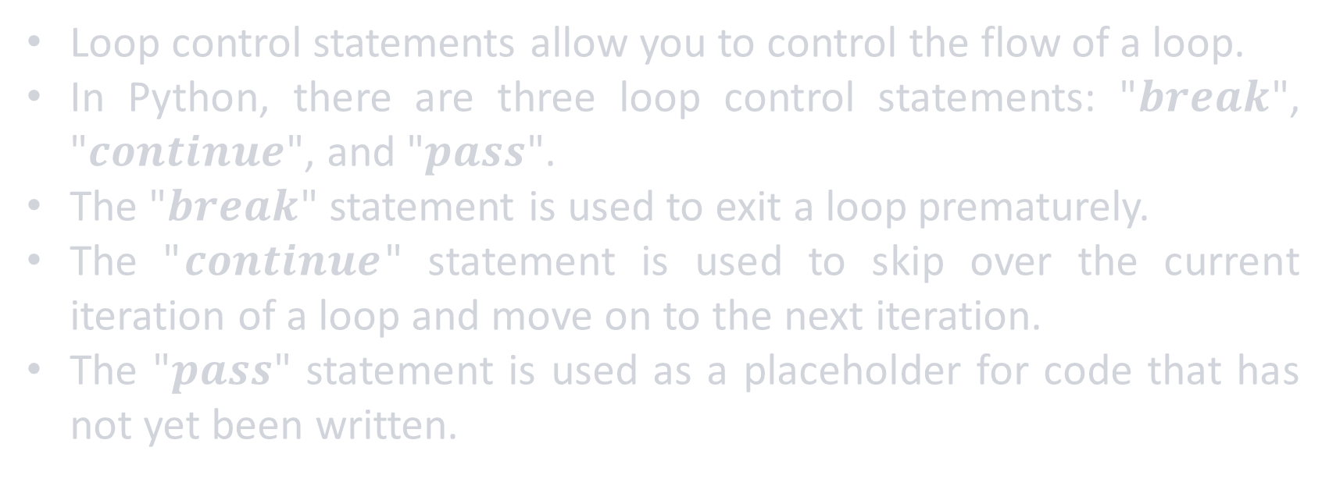
Loop Control Statements
Loop control statements allow you to control the flow of a loop.
In Python, there are three loop control statements: "$break$", "$continue$", and "$pass$".
The "$break$" statement is used to exit a loop prematurely.
The "$continue$" statement is used to skip over the current iteration of a loop and move on to the next iteration.
The "$pass$" statement is used as a placeholder for code that has not yet been written.

Slide 78
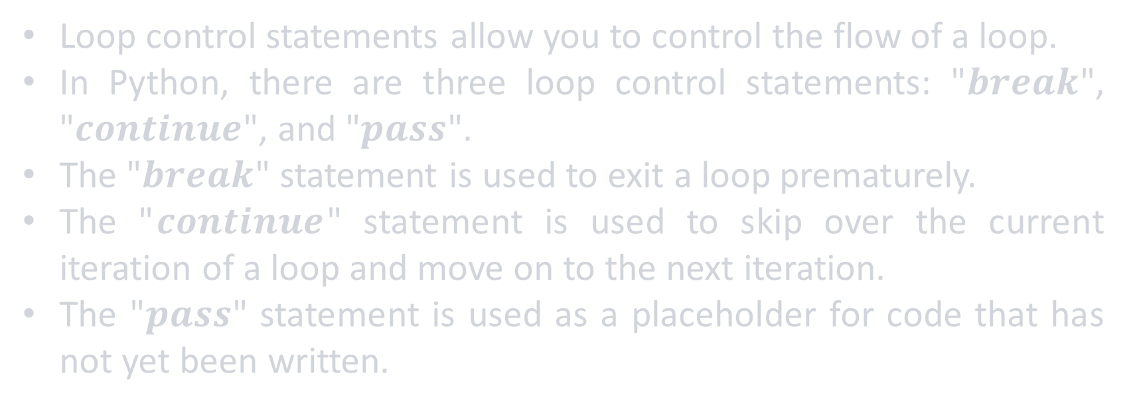
Loop Control Statements
Loop control statements allow you to control the flow of a loop.
In Python, there are three loop control statements: "$break$", "$continue$", and "$pass$".
The "$break$" statement is used to exit a loop prematurely.
The "$continue$" statement is used to skip over the current iteration of a loop and move on to the next iteration.
The "$pass$" statement is used as a placeholder for code that has not yet been written.
for i in range(1, 11):
if i % 2 == 0:
continue
print(i, end=' ')

Slide 79
Loop Control Statements
Loop control statements allow you to control the flow of a loop.
In Python, there are three loop control statements: "$break$", "$continue$", and "$pass$".
The "$break$" statement is used to exit a loop prematurely.
The "$continue$" statement is used to skip over the current iteration of a loop and move on to the next iteration.
The "$pass$" statement is used as a placeholder for code that has not yet been written.
for i in range(1, 11):
if i % 2 == 0:
continue
print(i, end=' ')
>> 1 3 5 7 9

Slide 80
Loop Control Statements
range(start, stop, step)
for i in range(1, 11):
if i % 2 == 0:
continue
print(i, end=' ')

Slide 81
Loop Control Statements
print(range(1, 11))
>> range(1, 11)
for i in range(1, 11):
if i % 2 == 0:
continue
print(i, end=' ')

Slide 82
Loop Control Statements
print(list(range(1, 11)))
>> [1, 2, 3, 4, 5, 6, 7, 8, 9, 10]
for i in range(1, 11):
if i % 2 == 0:
continue
print(i, end=' ')

Slide 83
Loop Control Statements
print(list(range(1, 11, 2)))
>> [1, 3, 5, 7, 9]
for i in range(1, 11):
if i % 2 == 0:
continue
print(i, end=' ')

Slide 84
Loop Control Statements
continue keyword for skipping over iterations
for i in range(1, 11):
if i % 2 == 0:
continue
print(i, end=' ')

Slide 85
Loop Control Statements
number_of_iterations = 10
for i in range(1, 11):
if i % 2 == 0:
continue
print(i, end=' ')

Slide 86
Loop Control Statements
number_of_iterations = 10
for i in range(1, 11):
if i % 2 == 0:
continue
print(i, end=' ')

Slide 87
Loop Control Statements
number_of_iterations = 10
i = 1
for i in range(1, 11):
if i % 2 == 0:
continue
print(i, end=' ')

Slide 88
Loop Control Statements
number_of_iterations = 10
i = 1
for i in range(1, 11):
if i % 2 == 0:
continue
print(i, end=' ')

Slide 89
Loop Control Statements
number_of_iterations = 10
i = 1
for i in range(1, 11):
if i % 2 == 0:
continue
print(i, end=' ')
>> 1

Slide 90
Loop Control Statements
number_of_iterations = 9
i = 1
for i in range(1, 11):
if i % 2 == 0:
continue
print(i, end=' ')
>> 1

Slide 91
Loop Control Statements
number_of_iterations = 9
i = 2
for i in range(1, 11):
if i % 2 == 0:
continue
print(i, end=' ')
>> 1

Slide 92
Loop Control Statements
number_of_iterations = 9
i = 2
for i in range(1, 11):
if i % 2 == 0:
continue
print(i, end=' ')
>> 1

Slide 93
Loop Control Statements
number_of_iterations = 9
i = 2
for i in range(1, 11):
if i % 2 == 0:
continue
print(i, end=' ')
>> 1

Slide 94
Loop Control Statements
number_of_iterations = 8
i = 2
for i in range(1, 11):
if i % 2 == 0:
continue
print(i, end=' ')
>> 1

Slide 95
Loop Control Statements
number_of_iterations = 8
i = 3
for i in range(1, 11):
if i % 2 == 0:
continue
print(i, end=' ')
>> 1

Slide 96
Loop Control Statements
number_of_iterations = 8
i = 3
for i in range(1, 11):
if i % 2 == 0:
continue
print(i, end=' ')
>> 1

Slide 97
Loop Control Statements
number_of_iterations = 8
i = 3
for i in range(1, 11):
if i % 2 == 0:
continue
print(i, end=' ')
>> 1

Slide 98
Loop Control Statements
number_of_iterations = 8
i = 3
for i in range(1, 11):
if i % 2 == 0:
continue
print(i, end=' ')
>> 1 3

Slide 99
Loop Control Statements
number_of_iterations = 7
i = 3
for i in range(1, 11):
if i % 2 == 0:
continue
print(i, end=' ')
>> 1 3

Slide 100
Loop Control Statements
for i in range(1, 11):
if i % 2 == 0:
continue
print(i, end=' ')
>> 1 3 5 7 9

Slide 101
Loop Control Statements
for i in range(1, 11):
if i % 2 == 0:
break
print(i)
print("hello!")
>> 1
hello!

Slide 102
Loop Control Statements
break keyword for exiting loops prematurely
for i in range(1, 11):
if i % 2 == 0:
break
print(i)
print("hello!")
>> 1
hello!

Slide 103
Example
Write a program that loops over a list of numbers and calculate it’s summation and then prints it

Slide 104
Example
lst = [1, 3, 3, 1, 14, 2, 2, 4, 5, 20, 100]
total = 0
for num in lst:
total += num
print(total)
>> 155

Slide 105
Functions

Slide 106
Functions

Slide 107
Functions
Why Functions?

Slide 108
Functions
functions are an essential part of programming because they allow you to break down complex tasks into smaller, more manageable pieces.

Slide 109
Functions
There are several reasons why functions are important in Python programming:
Code reuse: By defining a function once, you can reuse the same code multiple times throughout your program. This can save you a lot of time and effort, especially when working on larger projects.
Abstraction: Functions can be used to abstract away complex code or algorithms, making it easier to understand and work with. This can be especially helpful when working on complex projects with many moving parts.
Testing: Functions make it easier to test your code because you can isolate specific parts of your program and test them individually.

Slide 110
Functions
Overall, functions are a powerful tool in any programming language that can help you write more efficient, reusable, and maintainable code.

Slide 111
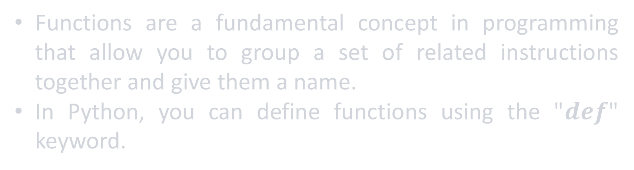
Functions
Functions are a fundamental concept in programming that allow you to group a set of related instructions together and give them a name.
In Python, you can define functions using the "$def$" keyword.

Slide 112
Functions
Functions are a fundamental concept in programming that allow you to group a set of related instructions together and give them a name.
In Python, you can define functions using the "$def$" keyword.
def function_name(parameters):
"""docstring"""
statements
return value
function_name(arguments)

Slide 113
Functions
Built in keyword
def function_name(parameters):
"""docstring"""
statements
return value
function_name(arguments)

Slide 114
Functions
function_name: The name you choose for your function
def function_name(parameters):
"""docstring"""
statements
return value
function_name(arguments)

Slide 115
Functions
parenthesis: Essential for functions
def function_name(parameters):
"""docstring"""
statements
return value
function_name(arguments)

Slide 116
Functions
def function_name(parameters):
"""docstring"""
statements
return value
function_name(arguments)
parameters: The inputs that your function will take (if any)

Slide 117
Functions
"""docstring""": A string that describes what your function does, and it is enclosed in triple quotes (optional)
def function_name(parameters):
"""docstring"""
statements
return value
function_name(arguments)

Slide 118
Functions
def function_name(parameters):
"""docstring"""
statements
return value
function_name(arguments)
statements: The instructions that your function will execute

Slide 119
Functions
def function_name(parameters):
"""docstring"""
statements
return value
function_name(arguments)
return value: Specifies the output that your function will produce (if any)

Slide 120
Functions
This is how we call the function
def function_name(parameters):
"""docstring"""
statements
return value
function_name(arguments)

Slide 121
Functions
def square(x):
"""Returns the square of x."""
return x ** 2
print(square(5))
>> 25

Slide 122
Functions
def square(x):
"""Returns the square of x."""
return x ** 2
help(square)
print(square(5))
>> Help on function square in module __main__:
square(x) Returns the square of x.
25

Slide 123
Functions
def find_sum(lst):
"""
This function takes a list of numbers as input and returns the sum of all the numbers in the list.
Args:
lst (list): A list of numbers.
Returns:
int or float: The sum of all the numbers in the list.
""" total = 0
for num in lst:
total += num
return total
print(find_sum([1, 3, 3, 1, 14, 2, 2, 4, 5, 20, 100]))
>> 155

Slide 124
Lambda functions

Slide 125
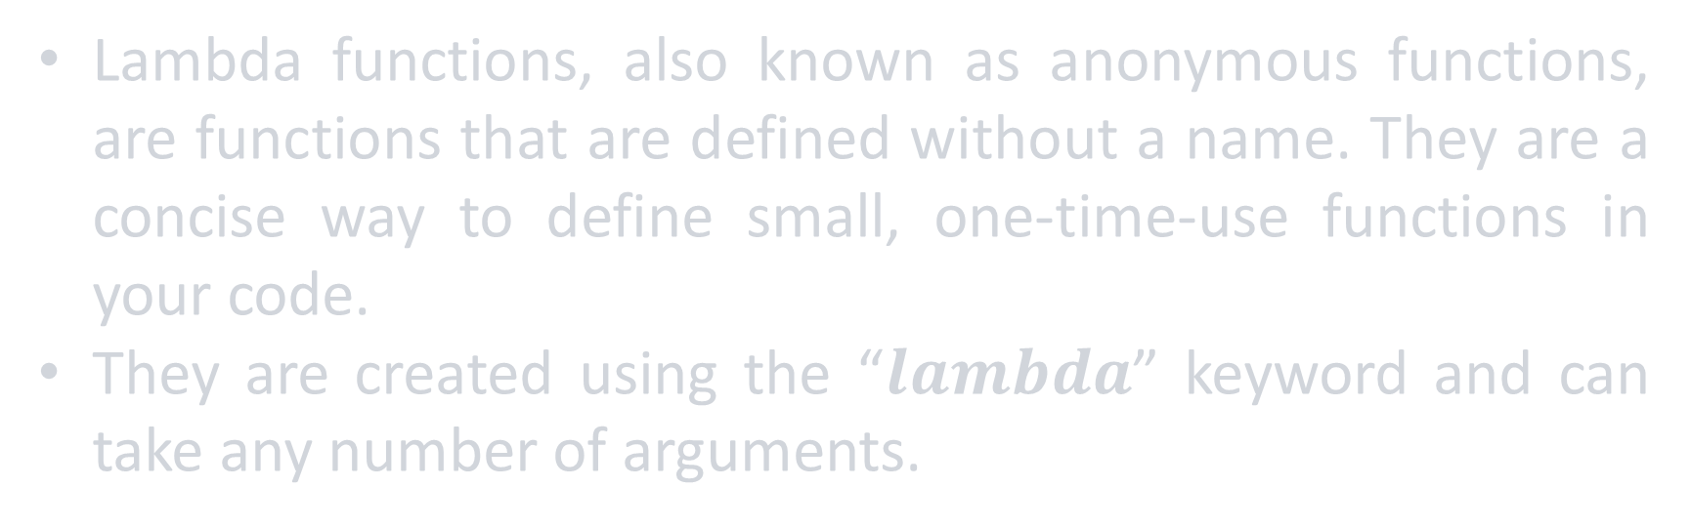
Lambda functions
Lambda functions, also known as anonymous functions, are functions that are defined without a name. They are a concise way to define small, one-time-use functions in your code.
They are created using the “$lambda$” keyword and can take any number of arguments.

Slide 126
Lambda functions
Why Lambda functions?

Slide 127
Lambda functions
There are several benefits to using lambda functions in your code:
Concise syntax: Lambda functions are a quick and easy way to define small, one-time-use functions without needing to write a full function definition.
Readable code: Lambda functions can make your code more readable by reducing the amount of boilerplate code needed for simple operations.
Functional programming: Lambda functions are a key part of functional programming, which can lead to more efficient and effective code.
Versatility: Lambda functions can be used in a wide variety of situations, including sorting, filtering, and mapping data.

Slide 128
Lambda functions
Built in keyword
Arguments
sum = lambda x, y: x + y
result = sum(3, 5)
print(result)
Expression
print(sum)
>> <function <lambda> at 0x000001CA3C12FE50>

Slide 129
Lambda functions
Built in keyword
Arguments
sum = lambda x, y: x + y
result = sum(3, 5)
print(result)
Expression
print(type(sum))
>> <class 'function'>

Slide 130
Lambda functions
sum = lambda x, y: x + y
result = sum(3, 5)
print(result)
>> 8

Slide 131
Lambda functions
numbers = [3, 1, 4, 1, 5, 9, 2, 6, 5, 3, 5]
sorted_numbers = sorted(numbers)
print(sorted_numbers)
>> [1, 1, 2, 3, 3, 4, 5, 5, 5, 6, 9]

Slide 132
Lambda functions
numbers = [3, 1, 4, 1, 5, 9, 2, 6, 5, 3, 5]
sorted_numbers = sorted(numbers, key=lambda x: -x)
print(sorted_numbers)
>> [9, 6, 5, 5, 5, 4, 3, 3, 2, 1, 1]

Slide 133
Lambda functions
fruits = ['banana', 'apple', 'orange', 'kiwi’]
sorted_ = sorted(fruits)
print(sorted_)
>> ['apple', 'banana', 'kiwi', 'orange']

Slide 134
Lambda functions
fruits = ['Banana', 'apple', 'orange', 'kiwi’]
sorted_ = sorted(fruits)
print(sorted_)
>> ['apple', 'banana', 'kiwi', 'orange']

Slide 135
Lambda functions
fruits = ['Banana', 'apple', 'orange', 'kiwi’]
sorted_ = sorted(fruits)
print(sorted_)
>> ['Banana', 'apple', 'kiwi', 'orange']

Slide 136
Lambda functions
fruits = ['Banana', 'apple', 'orange', 'kiwi']
sorted_ = sorted(fruits, key=lambda x: x.lower())
print(sorted_)
>> ['apple', 'Banana', 'kiwi', 'orange']

Slide 137
map functions
members = ['Nasser', 'abdelgawad’,
'ibrahim', 'mahmoud']

Slide 138
map functions
Function to be applied to each item of the iterable
members = ['Nasser', 'abdelgawad’,
'ibrahim', 'mahmoud’]
members = list(map(lambda x: x.upper(), members))
print(members)
>> ['NASSER', 'ABDELGAWAD', 'IBRAHIM', 'MAHMOUD']
The iterable that contains the items to be mapped

Slide 139
filter functions
members = ['Nasser', 'abdelgawad',
'ibrahim', 'mahmoud',
'nader', 'nada',
'nadia', 'nady']

Slide 140
filter functions
members = ['Nasser', 'abdelgawad',
'ibrahim', 'mahmoud',
'nader', 'nada',
'nadia', 'nady']
list(filter(lambda x: x.startswith('n'), members))

Slide 141
filter functions
members = ['Nasser', 'abdelgawad',
'ibrahim', 'mahmoud',
'nader', 'nada',
'nadia', 'nady']
list(filter(lambda x: x.startswith('n'), members))
>> ['nader', 'nada', 'nadia', 'nady']

Slide 142
filter functions
members = ['Nasser', 'abdelgawad',
'ibrahim', 'mahmoud',
'nader', 'nada',
'nadia', 'nady']
list(filter(lambda x: x.lower().startswith('n'), members))
>> ['Nasser', 'nader', 'nada', 'nadia', 'nady']

Slide 143
map vs filter
The map function is used to apply a given function to each item of an iterable (e.g. list, tuple, etc.) and returns a new iterable with the results.
The filter function is used to filter out elements from an iterable based on a given condition and returns a new iterable containing only the elements that satisfy the condition.

Slide 144
map vs filter
The map function is used to apply a given function to each item of an iterable (e.g. list, tuple, etc.) and returns a new iterable with the results.
The filter function is used to filter out elements from an iterable based on a given condition and returns a new iterable containing only the elements that satisfy the condition.

Slide 145
map vs filter
The map function is used to apply a given function to each item of an iterable (e.g. list, tuple, etc.) and returns a new iterable with the results.
The filter function is used to filter out elements from an iterable based on a given condition and returns a new iterable containing only the elements that satisfy the condition.

Slide 146
map vs filter
The map function is used to apply a given function to each item of an iterable (e.g. list, tuple, etc.) and returns a new iterable with the results.
The filter function is used to filter out elements from an iterable based on a given condition and returns a new iterable containing only the elements that satisfy the condition.

Slide 147
Modules

Slide 148
Modules
A module is a file containing Python definitions and statements.
The file name is the module name with the suffix .py added.
Modules can contain functions, classes, and variables.
Modules can be used to organize code and make it reusable.

Slide 149
Modules
Why Modules?

Slide 150
Modules
Python is a modular language, and modules are a fundamental concept in Python.
Modules help to avoid naming conflicts, as each module has its namespace.
Modules make it easy to reuse code and share code between different projects.
Many built-in modules are available in Python, such as math, os, and datetime.

Slide 151
File handling

Slide 152
File handling
File handling is the process of reading from and writing to files in your Python code. Python provides several built-in functions for file handling, including open(), read() and write()
file = open("example.txt", "r")
# do some work with the file file.close()

Slide 153
File handling
The file name
file = open("example.txt", "r")
# do some work with the file file.close()
The mode

Slide 154
File handling
file = open("example.txt", "r")
# do some work with the file
file.close()
Essential step to close the file

Slide 155
File handling
file = open("example.txt", "r")
# do some work with the file
file.close()
Not closing it will cause many problems

Slide 156
File handling
with open("example.txt", "r") as file:
# do some work with the file
# file is automatically closed after the `with` block

Slide 157
File handling
with open("example.txt", "r") as file:
lines = file.readlines()
processed_lines = list(map(lambda line: line.strip().upper(), lines))
file.close()
print(processed_lines)
>> ['HELLO WORLD']
The file content was “hello world”

Slide 158
File handling
File modes are:
"r":Read mode. This is the default mode for opening a file. It allows you to read the contents of the file, but not modify them.
"w":Write mode. This mode allows you to write to the file, overwriting its previous contents. If the file does not exist, it will be created.
"a":Append mode. This mode allows you to add content to the end of an existing file. If the file does not exist, it will be created.
"x":Exclusive creation mode. This mode creates a new file, but fails if the file already exists.
"b":Binary mode. This mode is used when working with binary files, such as images or audio files.
"t":Text mode. This mode is used when working with text files.
"+":Read and write mode. This mode allows you to read from and write to a file.

Slide 159
Wrapping up
Control flow:
If conditions {if, if-else, if-elif-else}.
Ternary operators.
Loops {for loops, while loops}.
Loop control statements {break, continue, pass}
Functions
Lambda functions
Map, filter and sorted functions
Modules
File handling
Thank you for sticking with us

Slide 160


